Slide 1

SPOTIFY MUSIC DATA MINING PROJECT
Prashant Chaudhary
Rohin Mehta
Arya Joshi
Tejas Joshi
Videet Malpe

Slide 2
Inspiration
If there is one thing that R-Vengers can’t live without is music. We all love music and getting lost in it.
Our inspiration for this project is curiosity behind finding out what features of music makes specific song out of the box.

Slide 3
About Spotify
Spotify is world’s largest music streaming platform
Spotify is a digital music streaming platform that gives you access to millions of songs and other content from artists across the globe
It has over 286 million monthly active users worldwide
Each day they are adding 20,000 new songs and 5 million playlists

Slide 4
Project Significance
Our Data Analysis on Spotify aims to discover general trends among music listeners and churn out insightful patterns by determining key influencers of track popularity
There is something magical about music and we have tried to find pattern between popular songs.

Slide 5




Our Project Overview
Data Acquisition
Data Cleaning
Descriptive Analysis
Exploratory Analysis
We have selected our data from GitHub because it has the most inclusive dataset
We cleaned our data using R programming language and Microsoft Excel
We conducted descriptive data analytics in order to understand data better using Mean, Median, Range and Histogram
We performed exploratory analysis to derive
Meaningful insights
From data

Slide 6


Data Acquisition
In order to get insights about how various music features affect specific track and track artist and visa versa. We found out most inclusive dataset based on out requirements on GitHub.
We have obtained our data from one of the gitHub’s repository i.e. Tidytuesday which was already scraped using Spotify’s API. We have selected data from this source because it had all the characteristics of a track necessary for music analysis.

Slide 7

Data Mining and Cleaning
We cleaned the data with the help of R programming and Microsoft Excel. Removing missing values and unwanted columns pulled out inconsistencies and major errors from the dataset. We also removed duplicate observations to avoid ambiguity. Further, we detected outliers in some of the numerical features of track and removed them to improve statistical analysis.

Slide 8

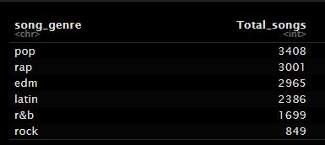
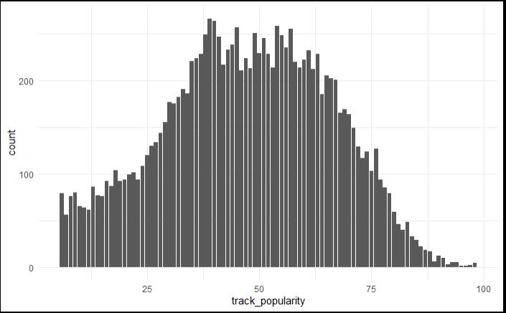
Descriptive Analysis
Measure of Centrality:
41.78 |Mean of Popularity
Total number of songs based on Genre
We observed that Histogram for popularity was
Normally distributed and Symmetric
44 | Median of Popularity
Measure of Spread
0 to 98 |Range of Popularity

Slide 9
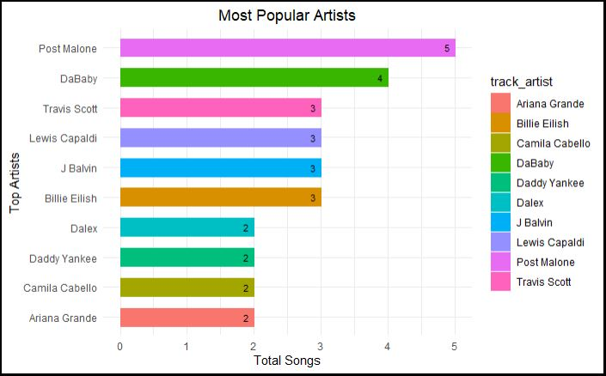
Exploratory Data Analysis:
Q1: Which artist has maximum number of songs in top 100 popular tracks over the last decade?
Answer: Post Malone has the highest number of hits over last decade

Slide 10
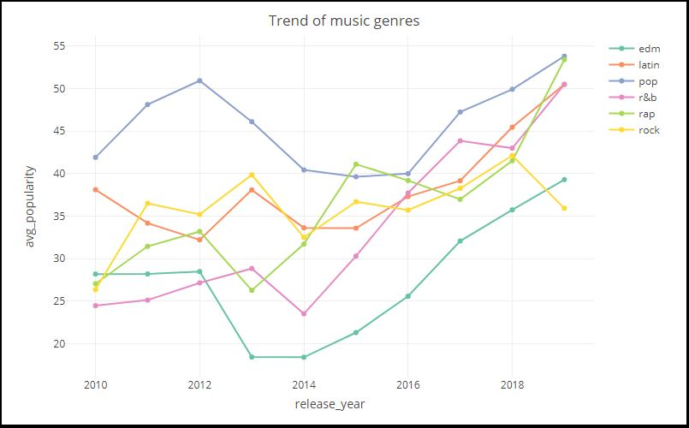
Exploratory Data Analysis:
Q2: Which music genre has become most popular over the last decade?
Answer: Pop has been the most popular genre in last decade.

Slide 11
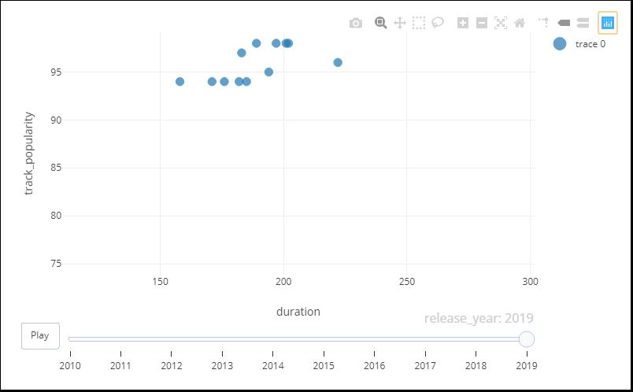
Exploratory Data Analysis:
Q3:For top popular songs in the last decade, does duration play a significant role?
Answer: Yes, the duration of the song impacts its track popularity. As the duration of a track decreases, its popularity has increased over the years. So it shows that users prefer listening to tracks with less run-time in seconds.

Slide 12
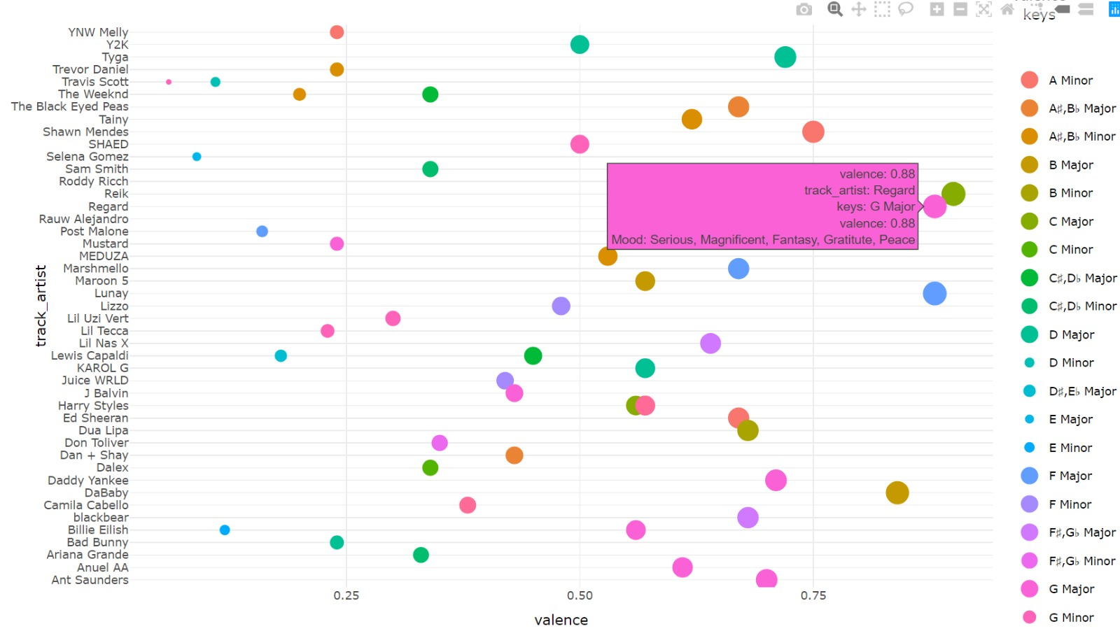
Exploratory Data Analysis:
Q4:For top popular songs in the last decade, does duration play a significant role?
Answer: It's evident that most of the popular tracks are based in the scale of G. And yes, there is a relationship between keys and valence levels for popular songs. So for higher valence keys resemble positive feelings.

Slide 13
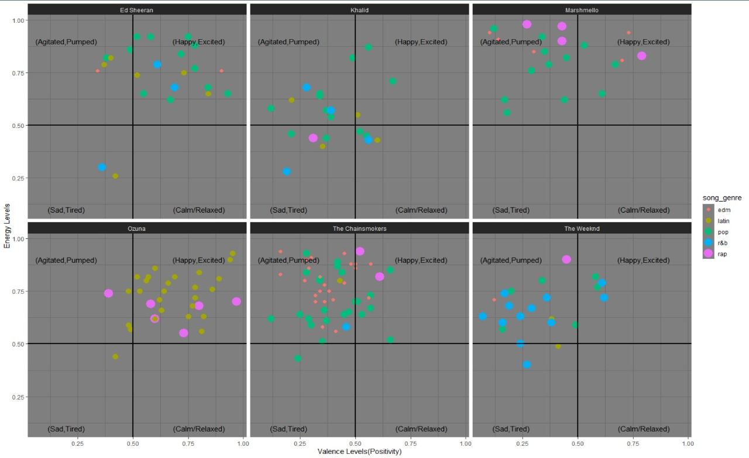
Exploratory Data Analysis:
Analyzing songs by top six popular artists(based on average popularity and a minimum of 20 tracks) for the last three years

Slide 14
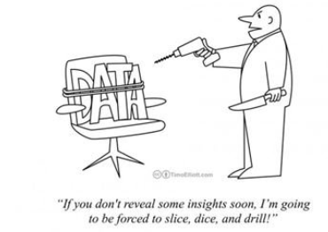
Conclusion

